Slide 1
DXC Techno-Thon’22 Codetta Cloud Provisioning and Monitoring
Shubham Saitwal

Slide 2
Codetta Cloud Provisioning and Monitoring
Problem Statement:
Manual intervention was the single possible way of handling infrastructure on Cloud.
Unlike conventional data center infrastructure management, where each configuration change called for manual action, with Codetta, infrastructure configuration data is stored in standardized files, which can be read by Shell script that maintain the state of the infrastructure with low-code approach without need of complex IaC platforms like Cloudformation, Azure ARM template etc.

Slide 3
Relevance(Usefulness) & Business Potential
Fast speed and consistency in provisioning of Infrastructure
The configuration of Infra can be modified just by changing the variables with minimal knowledge of IaC
Versioning and traceability: Easy to track and save the changes made by the developers
The complete system architecture can be shared using the code as descriptive approach is followed.
Generate the Infra back with minimum downtime while Disaster recovery
Highly Scalable as multiple cloud can be integrated by adding the Provider libraries

Slide 4
Solution Description & Innovation
The provisioning of cloud resources is one of the main use cases of Codetta.
It allows you to run your complete infrastructure code in IaC library. Even if your servers come from different cloud env such as AWS or Azure.
The USP of the solution is that even a novice can work in provisioning with minimal IaC knowledge without giving the full access to the production environment.
The solution will get better with the more libraries added to it.

Slide 5
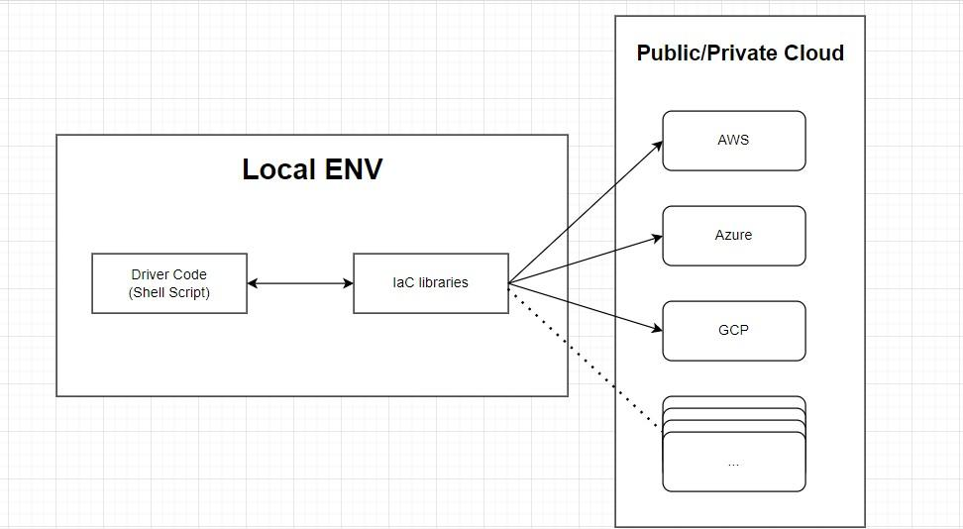
Architecture

